Slide 1
Introduction to Text Generation
杨润琦

Slide 2
Overview
Text generation basics
Definition and basic architectures
Evaluation metrics
Major problems and progress
Better network architecture
From greedy search to beam search
Generation control based on prior knowledge
Diversity Enhancement
Exposure bias alleviation
Tough problems and future directions

Slide 3
Overview
Text generation basics
Definition and basic architectures
Evaluation metrics
Major problems and progress
Better network architecture
From greedy search to beam search
Generation control based on prior knowledge
Diversity Enhancement
Exposure bias alleviation
Tough problems and future directions

Slide 4
Text Generation
A special case of sequence generation:

Slide 5
Loss
Negative Log Likelihood/Perplexity
Notes:
前三个主要是ngram，第四个加入了IDF，第五个考虑了parse tree

Slide 6
Applications
Translation
Image captioning
Summarization
Chatbot
……
Notes:
End to end, more expressive

Slide 7
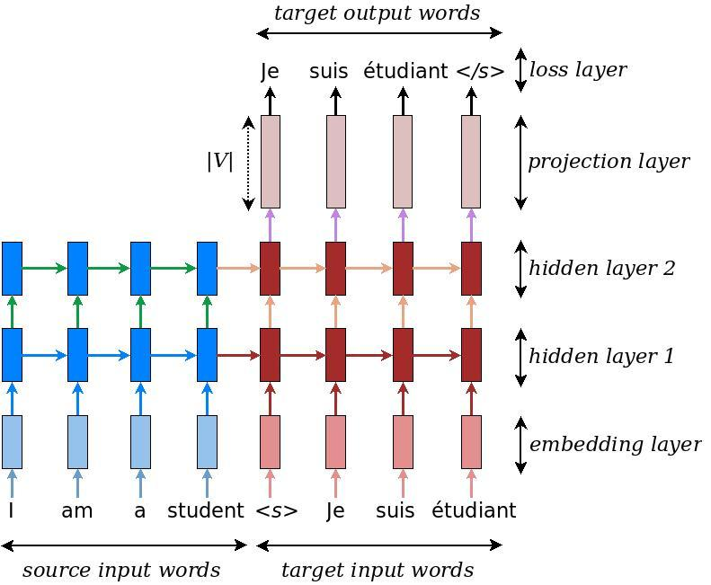
Basic Architecture: seq2seq
https://www.tensorflow.org/tutorials/seq2seq

Slide 8
Basic Architecture: im2txt
https://github.com/tensorflow/models/tree/master/research/im2txt

Slide 9
Overview
Text generation basics
Definition and basic architectures
Evaluation metrics
Major problems and progress
Better network architecture
From greedy search to beam search
Generation control based on prior knowledge
Diversity Enhancement
Exposure bias alleviation
Tough problems and future directions

Slide 10
Evaluation of text generation
Similarity: generation vs (multiple) reference
Translation, image captioning, summarization…
Related, diverse and interesting
Conversation, news commenting, image commenting…

Slide 11
Similarity Metrics
BLEU: Bilingual Evaluation Understudy
ROUGE: Recall-Oriented Understudy for Gisting Evaluation
METEOR: Metric for Evaluation of Translation with Explicit Ordering
CIDEr: Consensus-based Image Description Evaluation
SPICE: Semantic Propositional Image Caption Evaluation
EmbSim, WMD, … : Embedding based similarity
…
Notes:
前三个主要是ngram，第四个加入了IDF，第五个考虑了parse tree

Slide 12
Diversity
Self-BLEU
Fraction of distinct unigrams and bigrams
Coherence

Slide 13
The Only Reliable Evaluation Metrics
Human Evaluation

Slide 14
Overview
Text generation basics
Definition and basic architectures
Evaluation metrics
Major problems and progress
Better network architecture
From greedy search to beam search
Generation control based on prior knowledge
Diversity Enhancement
Exposure bias alleviation
Tough problems and future directions
Notes:
大体设计思路和方向

Slide 15
Limitations of RNN-based models
Slow due to sequential nature
Can’t build very deep LSTMs due to optimization unstability
-> capacity of learning is limited

Slide 16
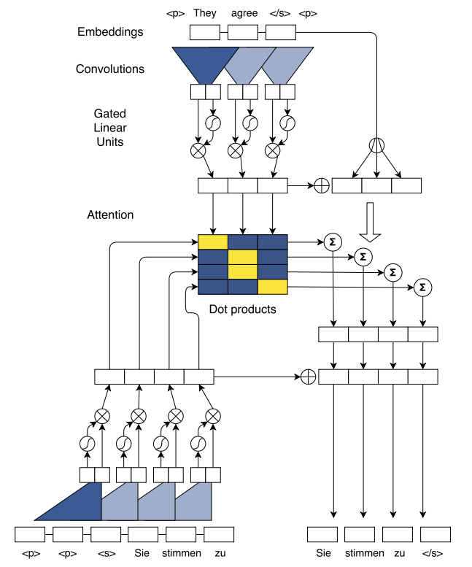
Convolutional seq2seq
Convolutional Sequence to Sequence Learning. https://arxiv.org/abs/1705.03122
Notes:
20 layers
Padding of decoder
Positional encoding

Slide 17
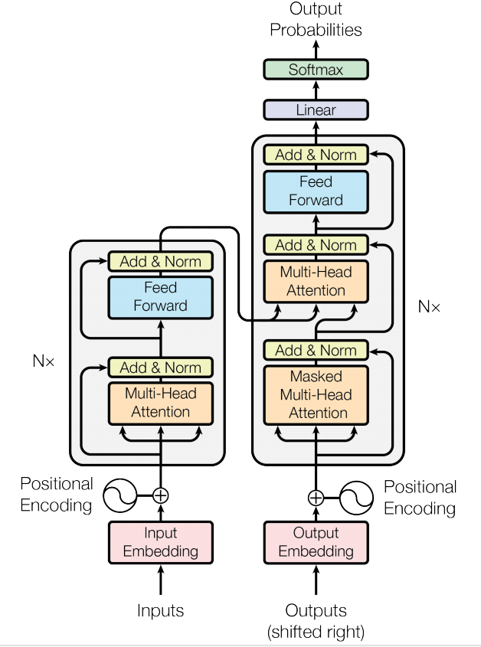
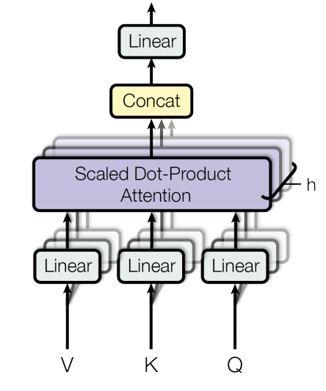
Transformer
Attention is All You Need. https://arxiv.org/abs/1706.03762
Notes:
6 layers *2/ *3
Postional encoding

Slide 18
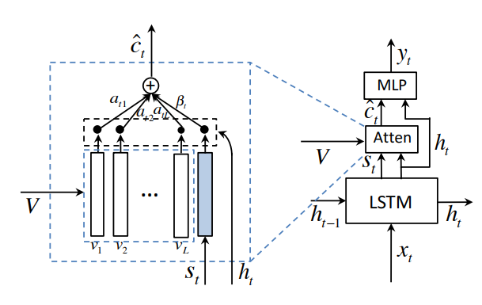
Knowing when to look
CNN encoder + RNN decoder
Selective attention
Image
text only (sentinel)
Knowing When to Look: Adaptive Attention via A Visual Sentinel for Image Captioning. https://arxiv.org/abs/1612.01887

Slide 19
Overview
Text generation basics
Definition and basic architectures
Evaluation metrics
Major problems and progress
Better network architecture
From greedy search to beam search
Generation control based on prior knowledge
Diversity Enhancement
Exposure bias alleviation
Tough problems and future directions

Slide 20
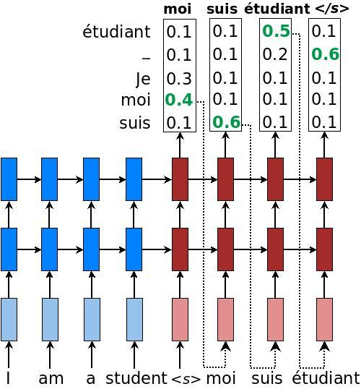
Greedy search
https://www.tensorflow.org/tutorials/seq2seq

Slide 21
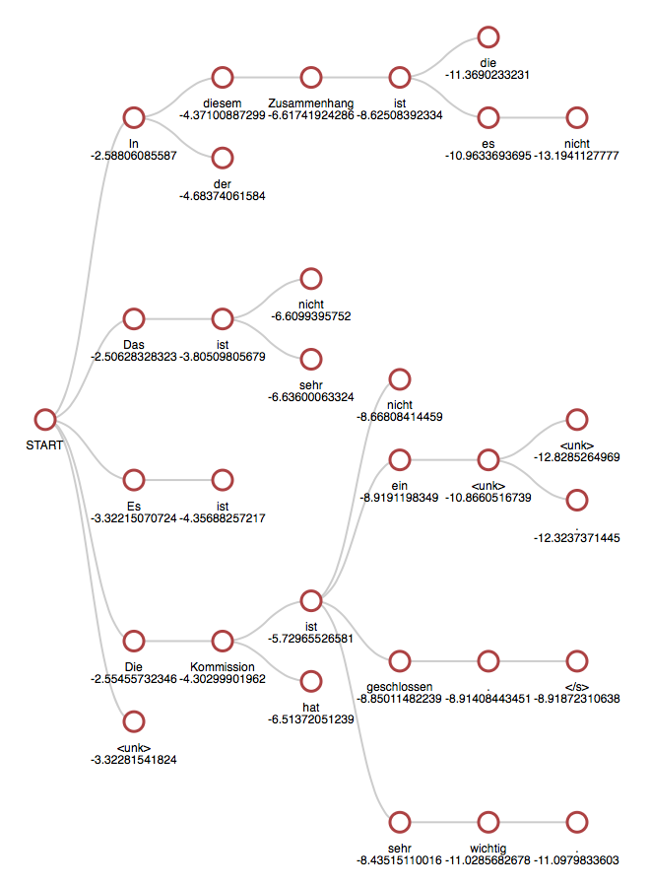
Beam search
Store best N hypothesis (N: beam size)
Between greedy search and breadth-first search
Implementation is REALLY difficult!!
Batched beam search
Tokens, scores & states reordering
Active & finished hypothesis
Length normalization
Early stopping or not
http://opennmt.net/OpenNMT/translation/beam_search/

Slide 22
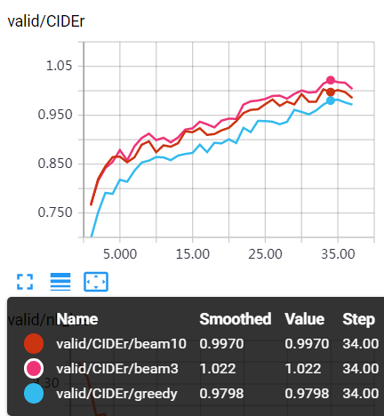
Beam size selection
Larger is not always better!
Small beam size serves as a way of regularization

Slide 23
Overview
Text generation basics
Definition and basic architectures
Evaluation metrics
Major problems and progress
Better network architecture
From greedy search to beam search
Generation control based on prior knowledge
Diversity Enhancement
Exposure bias alleviation
Tough problems and future directions

Slide 24
Constrained beam search
Length control
Only accept </eos> in the given range of steps
Forbidden words
Apply word penalty when scoring hypotheses
Fewer duplicated words
Apply duplication penalty when scoring hypotheses
Do not penalize function words (a, the, of …)

Slide 25
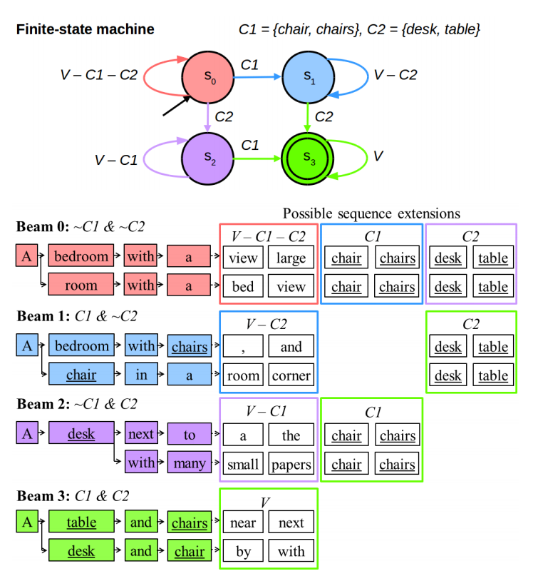
Constrained beam search
Suggested words:
A finite-state machine
Words expanded with WordNet lemmas
Guided Open Vocabulary Image Captioning with Constrained Beam Search. https://arxiv.org/abs/1612.00576

Slide 26
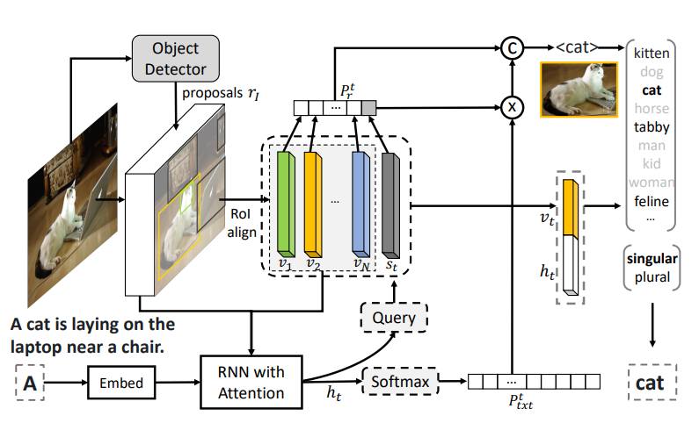
Template generation
Neural baby talk:
Generate template with slots
Switch words/slots by attention with sentinel
Tags can be further processed
Neural Baby Talk. https://arxiv.org/abs/1803.09845

Slide 27
Overview
Text generation basics
Definition and basic architectures
Evaluation metrics
Major problems and progress
Better network architecture
From greedy search to beam search
Generation control based on prior knowledge
Diversity Enhancement
Exposure bias alleviation
Tough problems and future directions

Slide 28
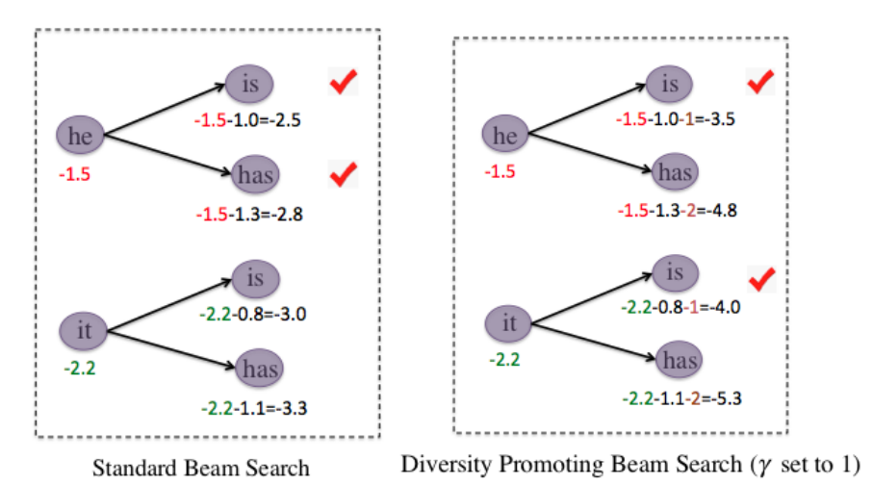
Diversity Promoting Beam Search
Penalize siblings (hypotheses in the same beam)
Penalty value can be optimized for each instance by reinforcement learning
A Simple, Fast Diverse Decoding Algorithm for Neural Generation. https://arxiv.org/pdf/1611.08562.pdf

Slide 29
GAN for text
GAN is not directly applicable for text generation
argmax in decoding is not differentiable
Attempts
GAN + reinforcement learning = SeqGAN
GAN + auto-encoder = ARAE
GAN + approximate embedding = GAN-AEL
SeqGAN: Sequence Generative Adversarial Nets with Policy Gradient. http://www.aaai.org/Conferences/AAAI/2017/PreliminaryPapers/12-Yu-L-14344.pdf
Adversarially Regularized Autoencoders. https://arxiv.org/abs/1706.04223
Neural Response Generation via GAN with an Approximate Embedding Layer. http://aclweb.org/anthology/D17-1065

Slide 30
Overview
Text generation basics
Definition and basic architectures
Evaluation metrics
Major problems and progress
Better network architecture
From greedy search to beam search
Generation control based on prior knowledge
Diversity Enhancement
Exposure bias alleviation
Tough problems and future directions

Slide 31
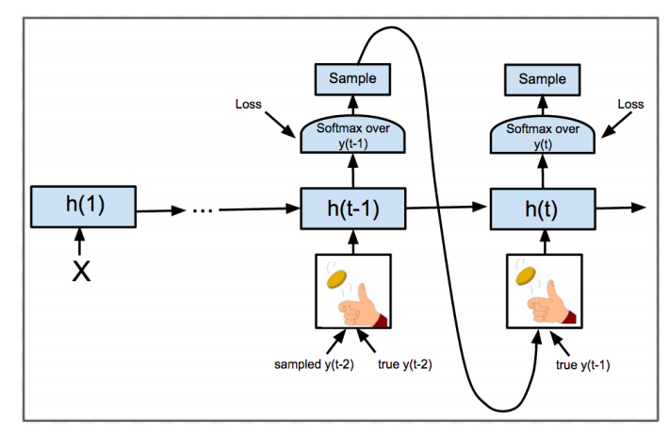
Exposure Bias Alleviation
Exposure bias
Training: ground truth tokens
Inference: tokens generated by the model itself
Text GAN doesn’t suffer from this problem
Scheduled sampling
A curriculum learning approach
Replace “true” previous tokens by generated ones with a increasing probability
Scheduled Sampling for Sequence Prediction with Recurrent Neural Networks. https://papers.nips.cc/paper/5956-scheduled-sampling-for-sequence-prediction-with-recurrent-neural-networks.pdf

Slide 32
Overview
Text generation basics
Definition and basic architectures
Evaluation metrics
Major problems and progress
Better network architecture
From greedy search to beam search
Generation control based on prior knowledge
Diversity Enhancement
Exposure bias alleviation
Tough problems and future directions

Slide 33
Future directions
Reliable automatic evaluation
Generation with memory for few-shot learning
End2end (Long) passage/story generation
…

Slide 34
Thanks for listening!
Q&A

